Slide 1
Risk Assessment

Slide 2

Risk
Risk :
Risk in information security means the potential for something bad to happen to your digital information.
This risk is a combination of three things:
Threats
Vulnerabilities
Impact
Notes:
It's like the chance of your computer or data being harmed by things like hackers, viruses, or mistakes made by people.
Threats: These are the bad things that could happen, like a hacker trying to break into your computer.
Vulnerabilities: These are weaknesses in your computer or how you use it, making it easier for threats to cause harm.
Impact: This is what could go wrong if a threat succeeds, such as losing important data or money.

Slide 3
Risk Management
Risk Management: Is the process of Identifying , assessing and evaluating the level of risk facing the organization sensitive information and information systems.
For example, a business might identify the risk of a computer system crashing. To manage this risk, they might regularly back up important data, install antivirus software, and have a plan in case the system goes down to minimize disruption.

Slide 4
Identifying Risks
Identifying risks in information security is a critical process that involves identifying potential threats, vulnerabilities, and weaknesses in an organization's information systems and data.
In this phase, the goal is to figure out what information the organization has, put it into categories, and decide which ones are most important.

Slide 5
Risk assessment
Risk assessment in information security is the process of identifying, analysing, and evaluating potential risks and vulnerabilities to an organization's information assets, systems, and data.
The primary goal of risk assessment is to understand the potential threats and vulnerabilities that could impact the confidentiality, integrity, and availability of sensitive information.
determine the level of risk associated with these factors.

Slide 6
Why risk assessment is important?
Risk assessment helps identify potential security threats.
It evaluates the likelihood of these threats occurring.
Measures the chance of security problems happening.
Evaluates how much harm these issues can cause.
Helps decide which security measures to focus on.
Safeguards sensitive data.

Slide 7

Information Security Risk Assessment Steps
Identification of Assets: The first step in risk assessment is identifying and documenting all the information assets within your organization.
This includes data, hardware, software, networks, and personnel.

Slide 8
Information Assets
IS
Components
People
Employees
Authorized
Staff
Other staff
Non-
employees
People at
trusted
organizations
Strangers
Procedures
Standard
\Procedures
Sensitive
Procedures
Data
Transmission
Process
Storage
SW
Application
OS
Security
Component
HW
System
Devises
Net Work
Notes:
Information assets refer to the valuable and important pieces of information and data that an organization possesses

Slide 9
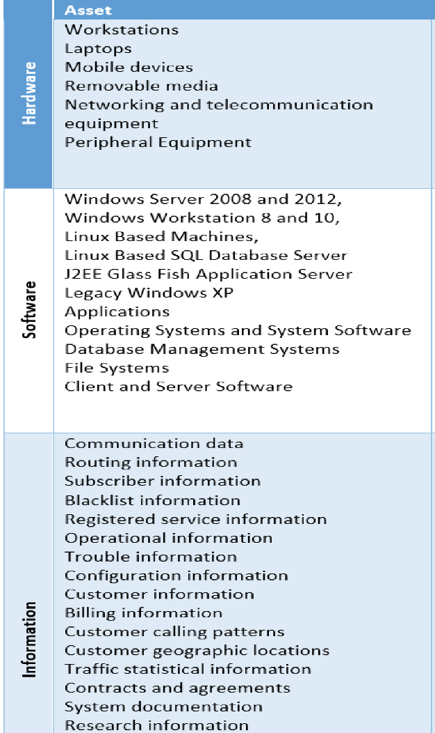
Information Assets
Notes:
Information assets refer to the valuable and important pieces of information and data that an organization possesses

Slide 10

Threat Identification
Threat Identification: Identify potential threats and vulnerabilities that could harm your information assets.
Threats can include hackers, malware, physical theft, natural disasters, and more.

Slide 11
Threat Identification
network
based attacks
virus infection,
unauthorized access
Human Threats
floods
Earthquakes
hurricanes
Outside &
Natural Threats
Environmental
Threats
Power failure,
pollution

Slide 12
Vulnerability Assessment
Vulnerability Assessment: Assess the weaknesses or vulnerabilities in your organization's security controls, processes, and systems.
This involves evaluating how susceptible your assets are to threats.

Slide 13
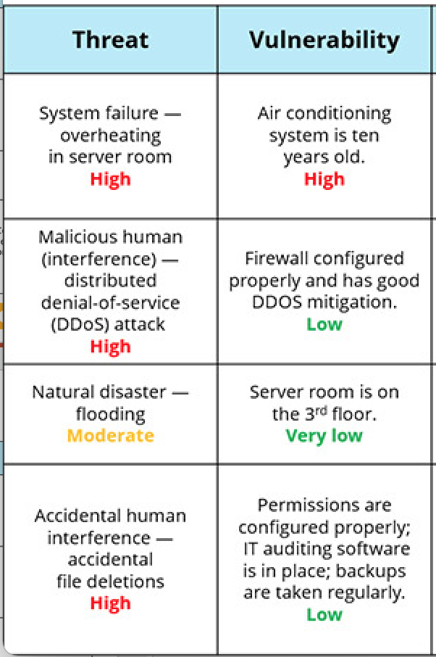
Vulnerability Assessment

Slide 14

Risk and How to use a Risk Matrix

Slide 15
Risk Analysis
Risk Analysis: Calculate the level of risk associated with each identified threat and vulnerability.
This typically involves assigning likelihood and impact values to each risk.
Common methods for risk analysis include qualitative, quantitative, and semi-quantitative approaches.

Slide 16
Risk Analysis Methods
Qualitative Risk Assessment: This method involves assessing risks using subjective measures such as low, medium, or high risk based on expert judgment.
Quantitative Risk Assessment: This approach assigns numerical values to risks, often using financial metrics to quantify potential losses.
Semi-Quantitative Risk Assessment: A combination of qualitative and quantitative methods, where risks are assessed with some degree of numerical analysis and expert judgment.

Slide 17
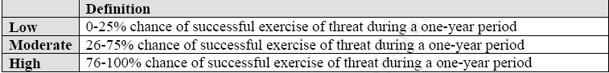
likelihood
Likelihood refers to the probability or chance that a specific event, incident, or threat will occur.
It is typically expressed as a qualitative or quantitative measurement, such as high, medium, low, or as a percentage (e.g., 20% chance of occurrence).
Assessing likelihood helps organizations understand the frequency of potential risks.

Slide 18
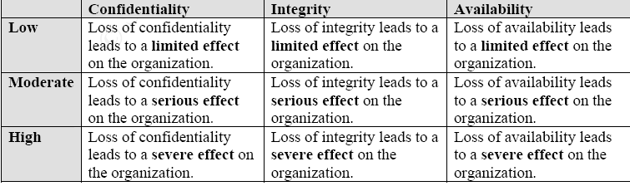
Impact
"impact" refers to the potential harm or damage that can occur if a security incident or breach takes place. It's about understanding the consequences of a security event.
Impact is often categorized as high, medium, or low.
Assessing impact helps organizations understand the main of the potential harm or loss associated with a risk.

Slide 19
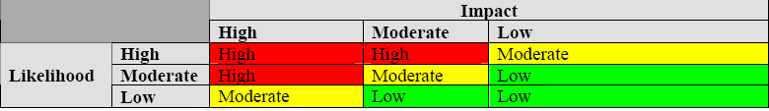
Risk Determination Matrix

Slide 20
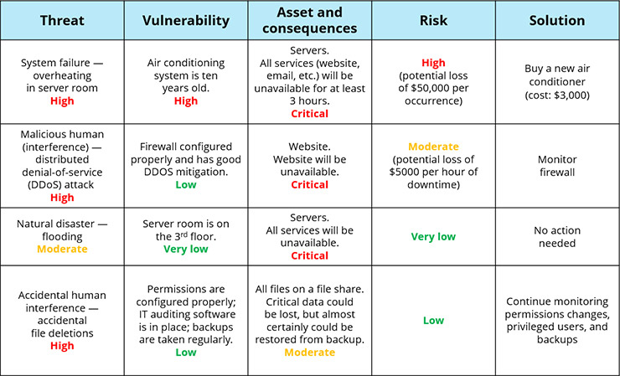
Risk Analysis Assessment

Slide 21
Common Risk Assessment methodologies
ISO 27001 Risk Assessment:
Description: ISO 27001 is a widely recognized information security standard that includes a specific risk assessment methodology. It focuses on identifying and assessing risks to information assets.
Process: It involves identifying assets, assessing threats and vulnerabilities, determining risk levels, and selecting appropriate security controls to mitigate risks.

Slide 22
Common Risk Assessment methodologies
NIST Risk Management Framework:
Description: The National Institute of Standards and Technology (NIST) provides a comprehensive risk management framework, primarily aimed at U.S. federal agencies but widely adopted elsewhere.
Process: It includes steps such as categorizing systems, selecting security controls, implementing controls, assessing security, and monitoring security on an ongoing basis.

Slide 23
Activity
Work in your CW1 assignment and focus in first point
Complete the following tasks:
Task 1: Risk Assessment.
Perform a risk assessment on the organisation in the case study. Identify potential threats, vulnerabilities, and impacts to the organisation's information assets. Explain how risk assessment assists in determining the appropriate security measures to mitigate these risks.
See the case study example and follow the steps to use it for risk assessment

Slide 24
What’s next on the agenda?
Break: 20 minutes
Lab Explanation
Lab Work

Slide 25


